Slide 1
Spot To Go
Discover Restaurants. Watch Real Videos. Get There Fast.
Final Project Presentation
University of East Anglia • August 2026

Slide 2
THE PROBLEM
Choosing Where To Eat Is Still A Guess
● Star ratings don't show what a place actually feels like
● Short text reviews are easy to skim past — or fake
● You still don't know if it's “your kind of place” until you're there
Spot To Go
2

Slide 3
THE IDEA
Spot To Go
● Shows nearby restaurants on a live map
● Tap one to watch a real video preview — see it before you go
● One more tap gives you directions there
Spot To Go
3

Slide 4
WHAT THE APP DOES
Five Things It Lets You Do
1. Sign in securely
2. See restaurants near you on a live map
3. Search by name or keyword
4. Watch a real video preview
5. Get instant directions
Spot To Go
4

Slide 5
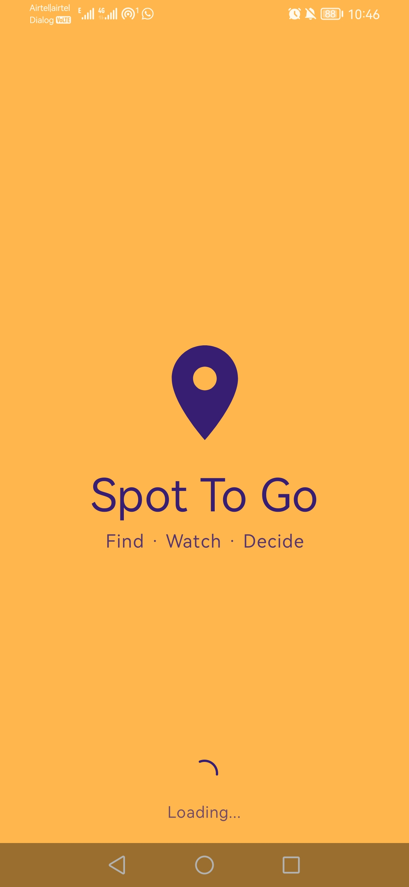
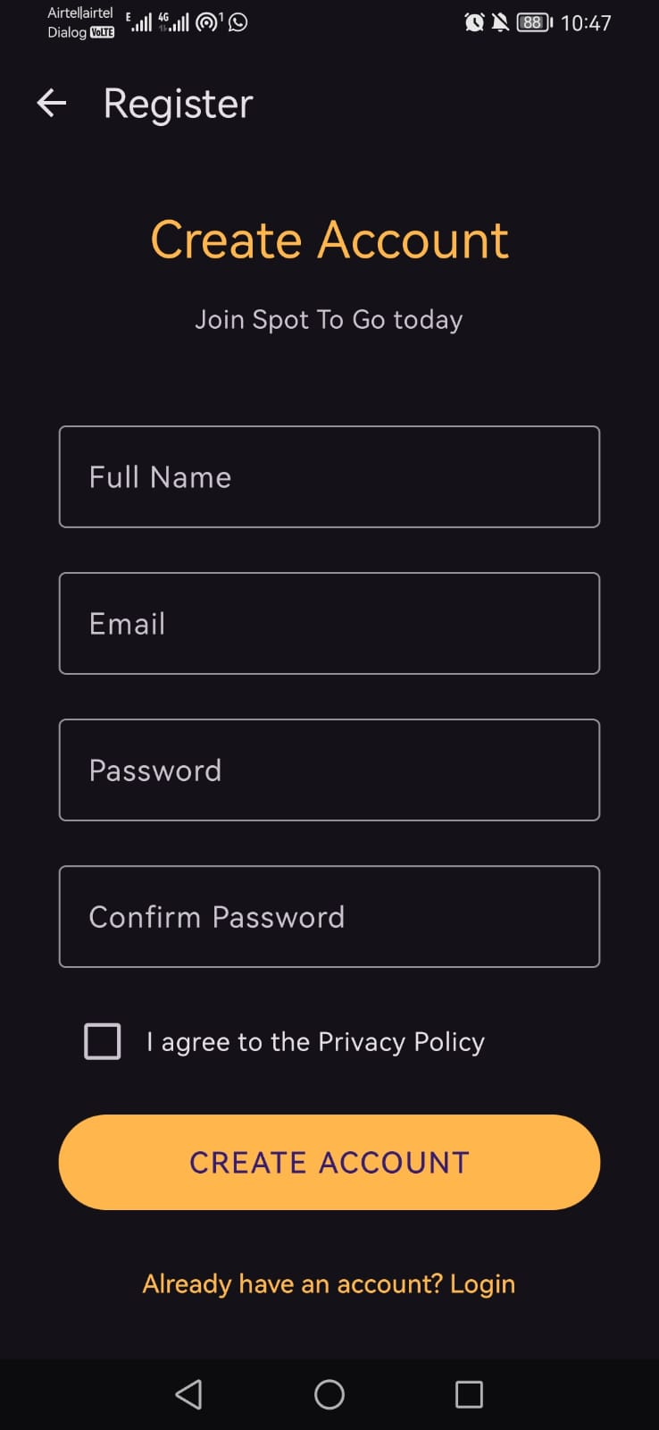
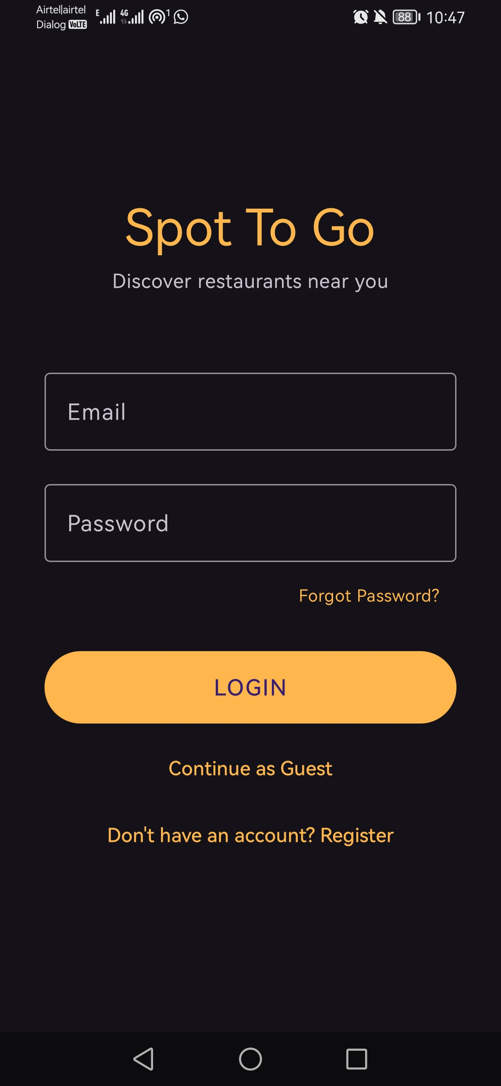
THE APP
Getting In
Splash
Register
Login
New user? Create an account first. Already have one? Sign straight in.
Spot To Go
5

Slide 6
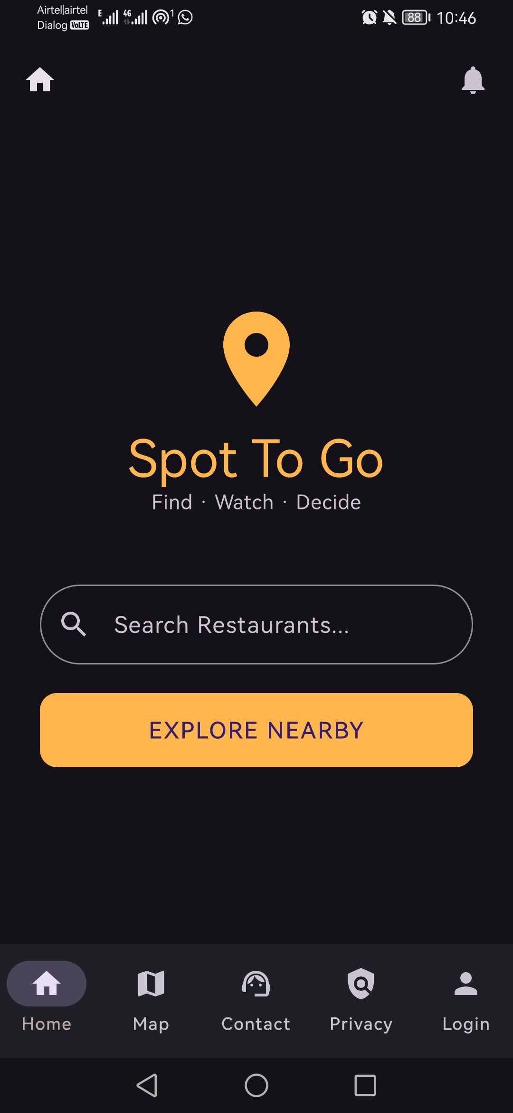
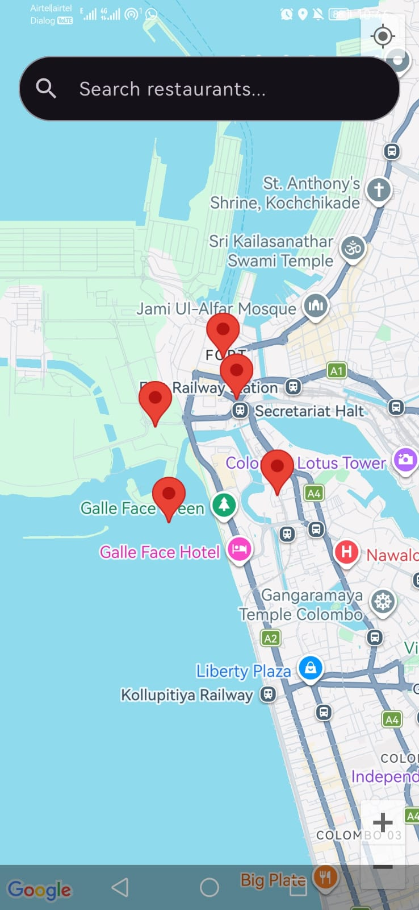
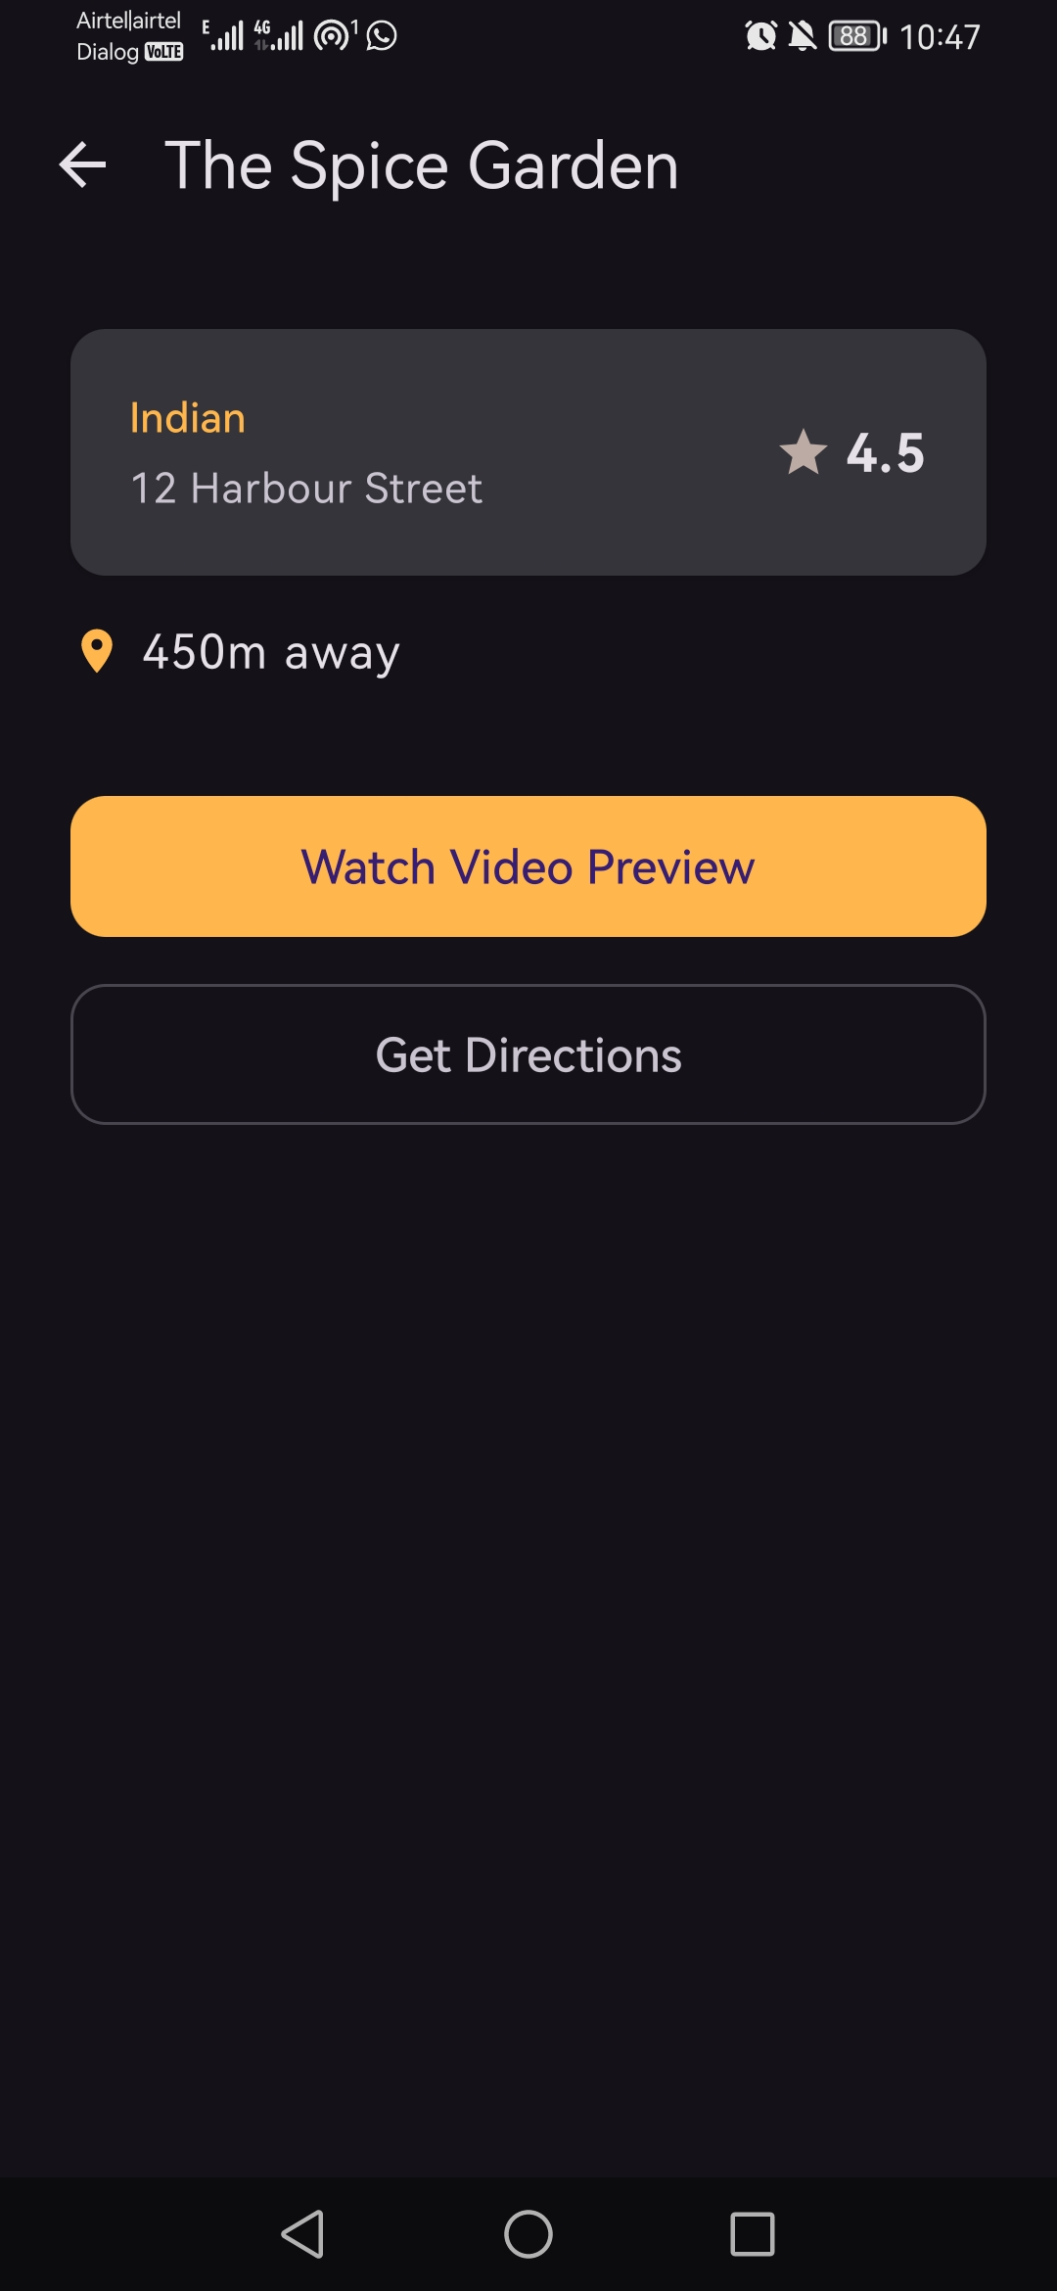
THE APP
Finding A Restaurant
Home
Map
Details
Search or explore nearby, tap a marker, see the full details.
Spot To Go
6

Slide 7
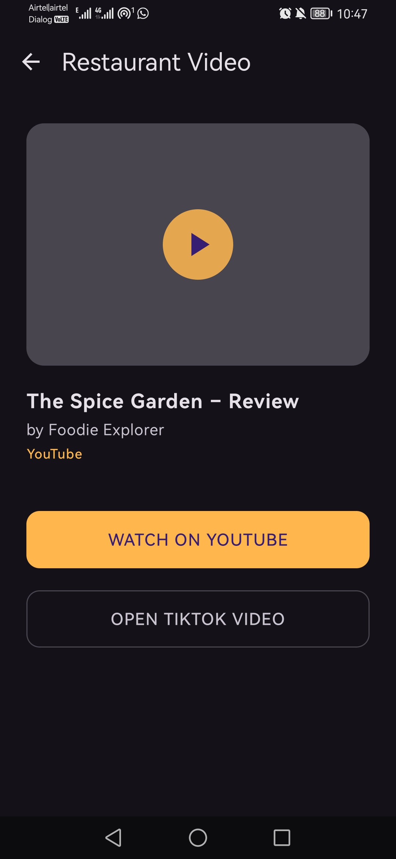
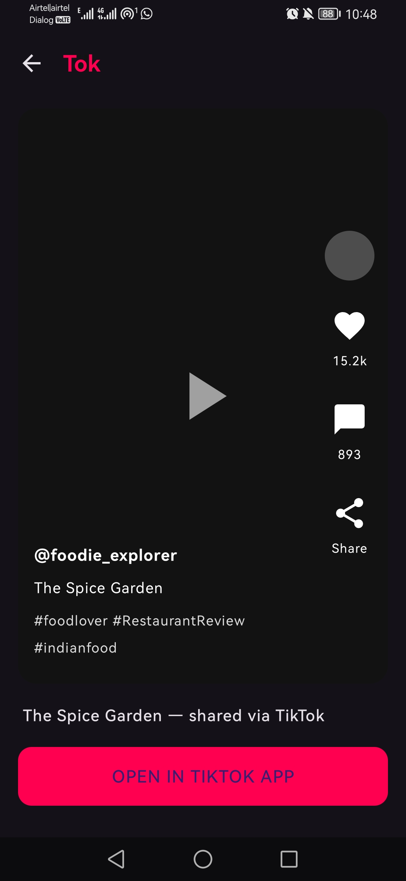
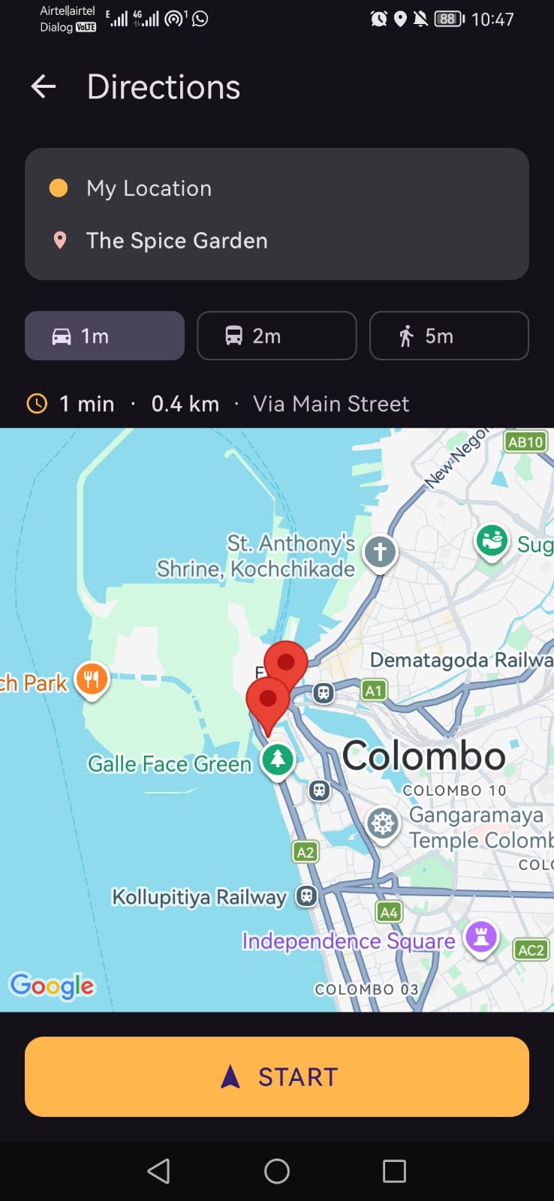
THE APP
Deciding & Going
Video
TikTok
Directions
Watch a real preview, then get turn-by-turn directions.
Spot To Go
7

Slide 8
UNDER THE HOOD
In Plain Terms
● Built for Android using Kotlin
● Uses the phone's real GPS location
● Real Google Map with live restaurant markers
● Secure sign-in — the app never stores your password itself
● Video and Directions buttons open the real YouTube, TikTok and Google Maps apps
Spot To Go
8

Slide 9
TESTING
Tested On A Real Phone
● Every screen tested end-to-end on a physical Android device
● 5 real issues found — and fixed — during testing
● Example: the keyboard was covering the password box — fixed
● Example: no way back from the map screen — added a menu bar
● Every screen connects correctly to the next
Spot To Go
9

Slide 10
WHAT'S NEXT
What's Left To Do
1. Connect to real, live nearby restaurants (Google Places API)
2. Make search pull results from those live listings
3. A few small polish fixes, plus more testing
Spot To Go
10

Slide 11
SUMMARY
Where Things Stand
● All 11 screens built and connected
● Real login, tested on a real phone
● Map uses the user's real GPS location
● Real video previews and real directions, one tap away
● One clear next step: live restaurant data
Spot To Go
11

Slide 12
Thank You
Questions?

